Slide 1

Backorder Prediction
By,
1. Pradyoth Singenahalli P rabhu
2. Varun W R
3. Bharath Anand

Slide 2
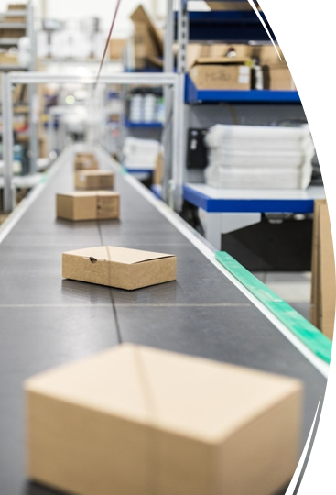
Introduction
Backorders are products that are temporarily out of stock, but a customer is allowed to place an order against future stock. The problem is when a product is not immediately available, customers may not have the patience to wait. This results into lost sales and low customer satisfaction. In order to avoid such scenarios machine learning (ML) tools can be applied to identify products that are at a risk of backorders.

Slide 3




Problem Statements
Predicting backorders to manage inventory and avoid supply chain disruptions.
Anticipating backorders to minimize customer dissatisfaction and maintain sales revenue.
Forecasting backorders to ensure timely product availability.
Machine learning-based backorder prediction to mitigate stockouts and prevent lost sales.

Slide 4
Architecture
Prepare Data
Build and Train Models
Deploy and UI
Data
Preparation
Model Building and Training
Model Deployment
Data Ingestion
Hyper Parameter Tuning
Deployment
Transformation
Model Selection
UI Interface
Validation
Model Validation
Feature Selection
Model Testing
Data Storage
Locations

Slide 5
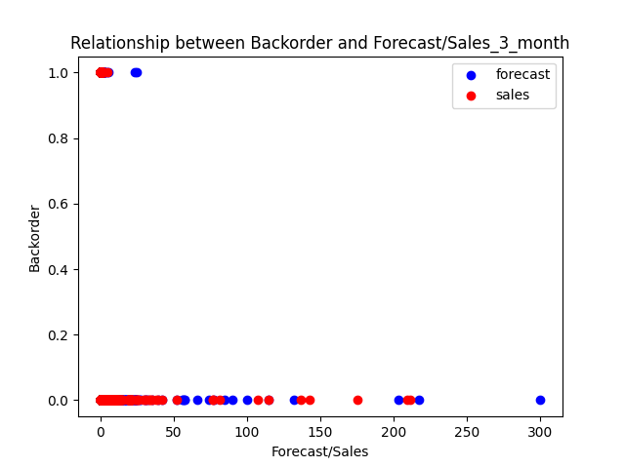
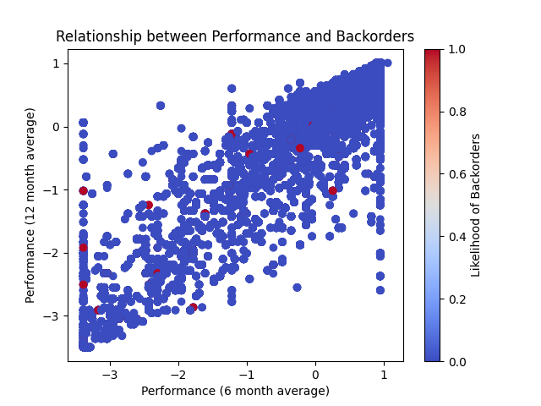
Visualization (EDA)
Relationship between Backorder and Forecast/Sales_3_month
Relationship between Performance and Backorders

Slide 6
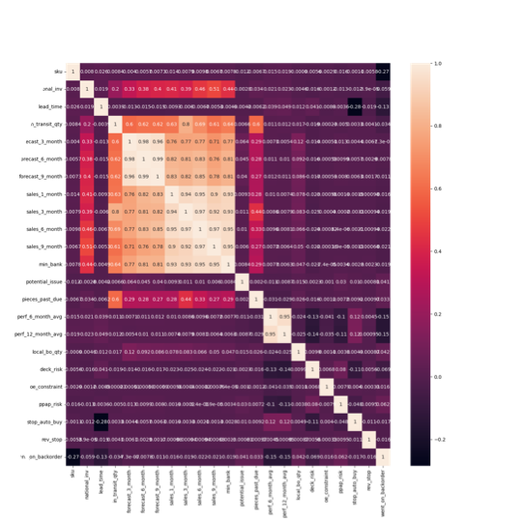
Methodology
Pre-processing:
Converting Boolean values to Binary values.
Replacing unknown values
Replacing -99 in perf_6_month with NaN values
Replacing -99 in perf_6_month with NaN values.
Handling missing values Iterative imputer.
Handled the imbalanced data.
Correlation
Heatmap

Slide 7
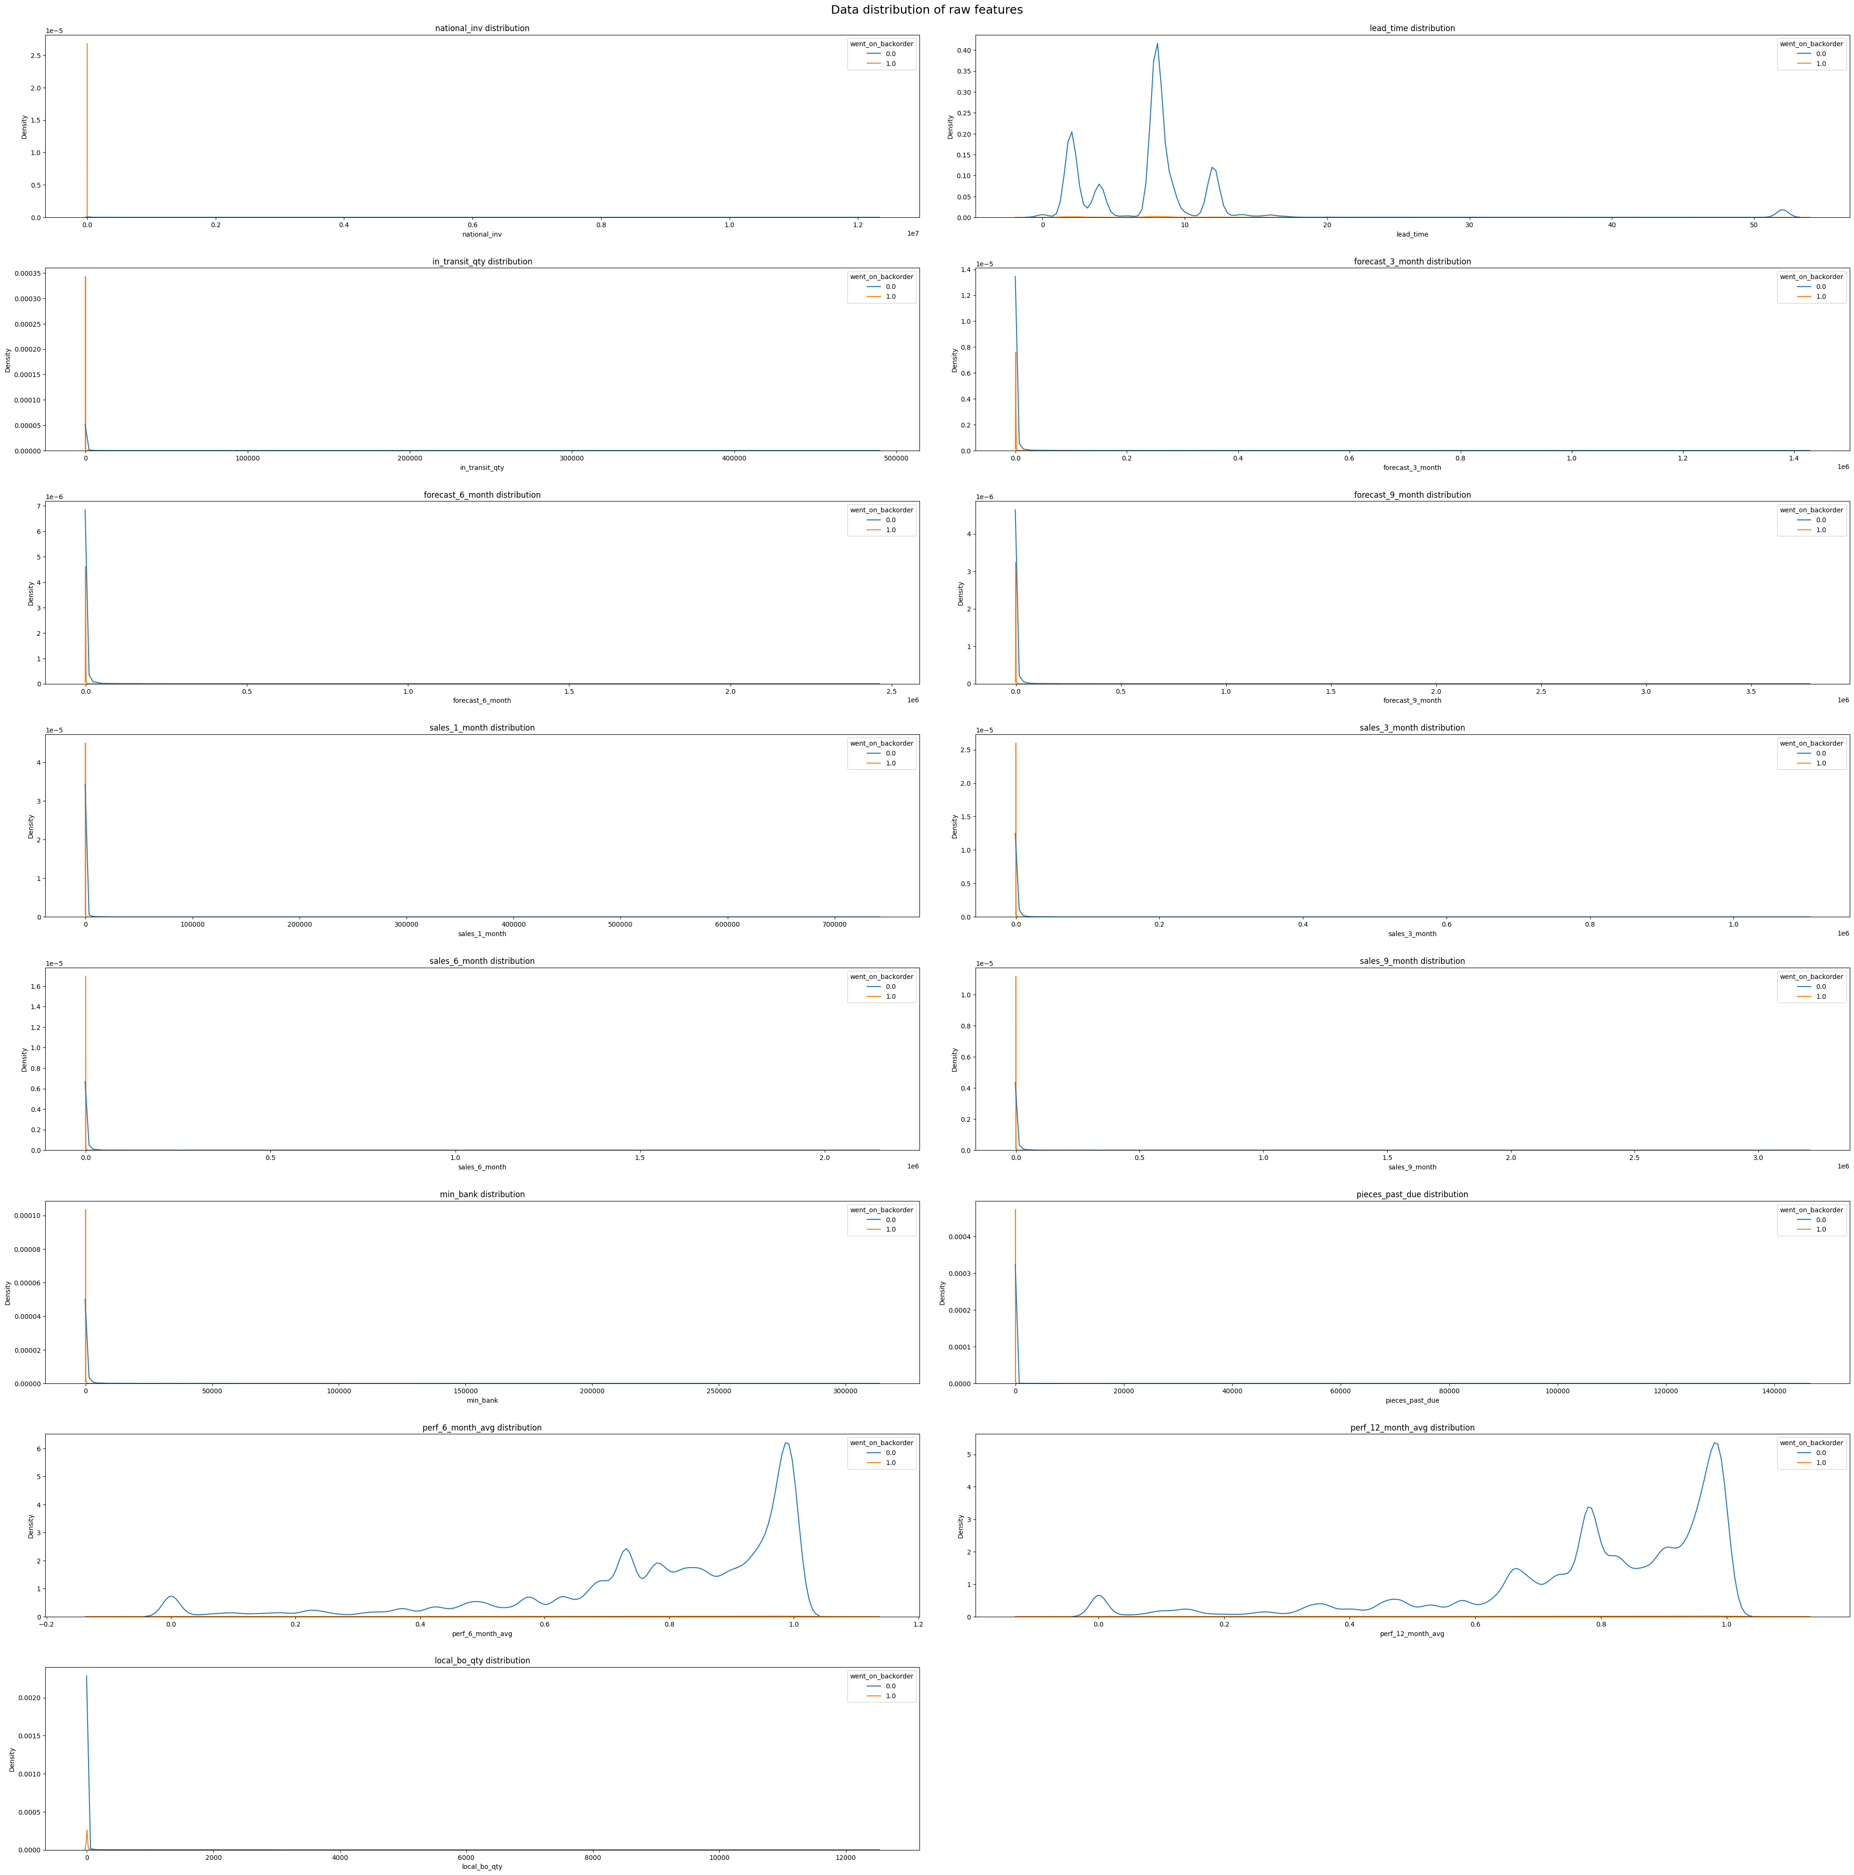
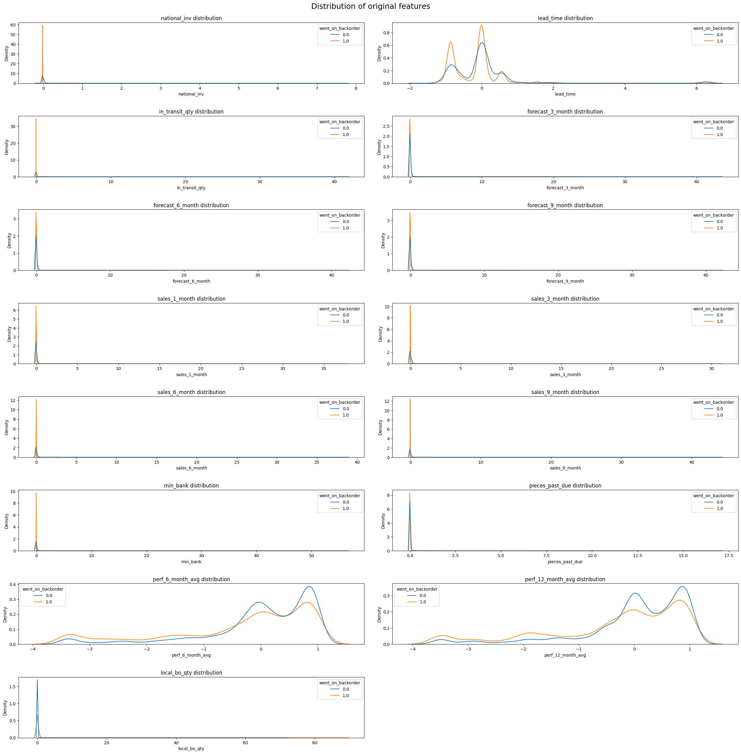
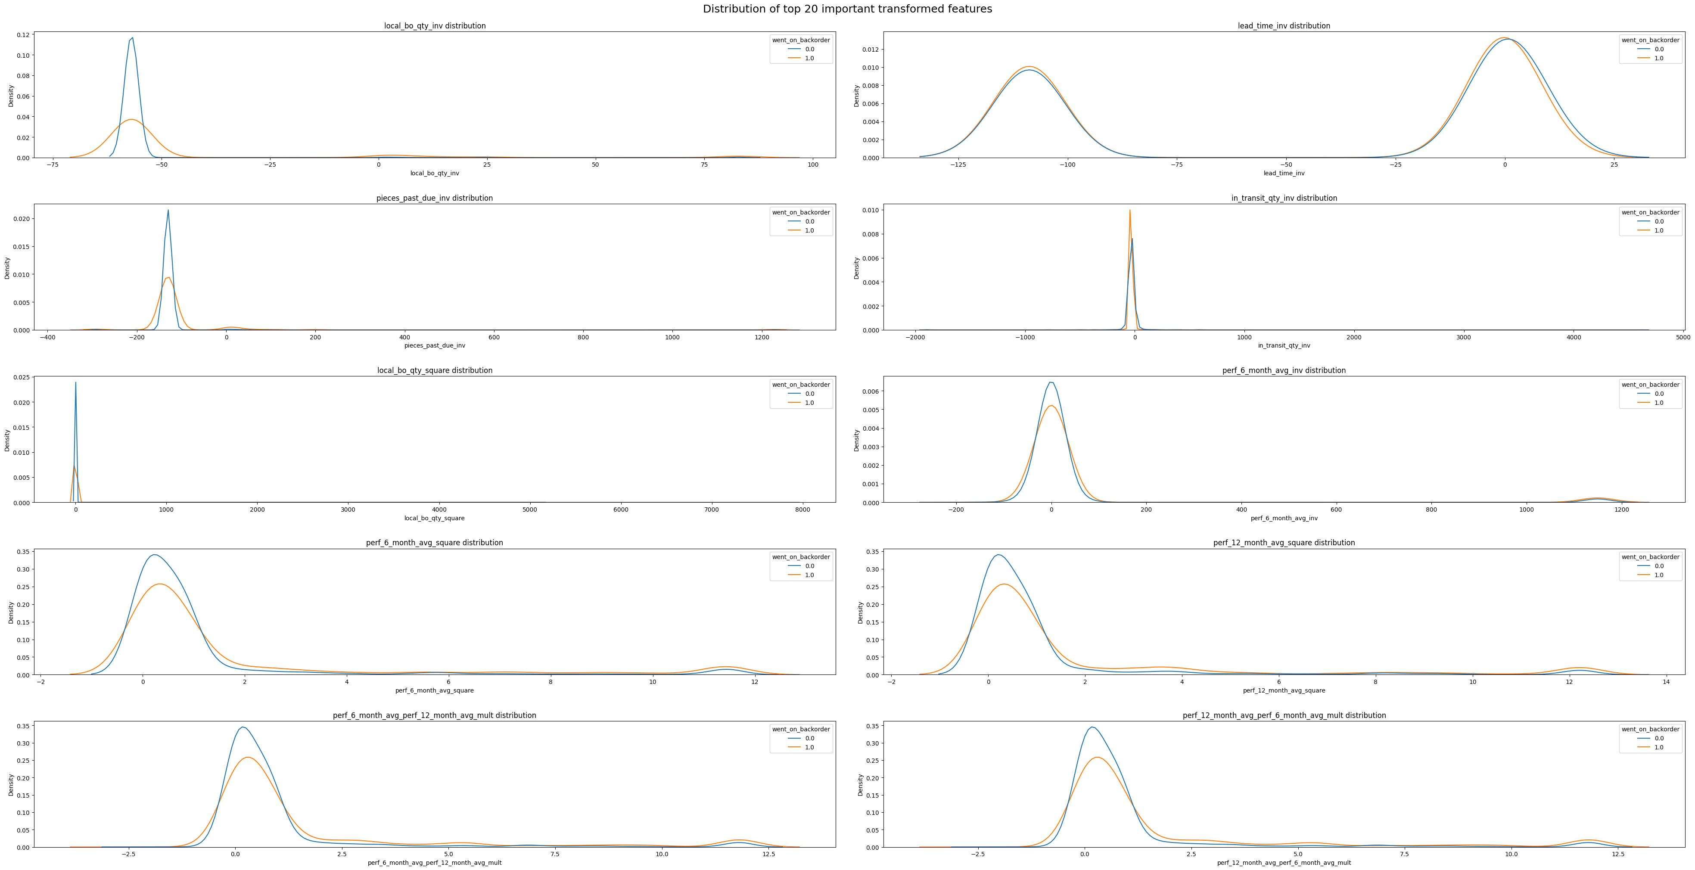
Methodology
Feature Selection:
Most important features that will influence the backorder prediction.
Distribution of Raw Features
Distribution of transformed Features

Slide 8

Methodology
Machine Learning Algorithms:
Decision Tree Algorithm
Random Forest Algorithm
Light GBM Algorithm

Slide 9
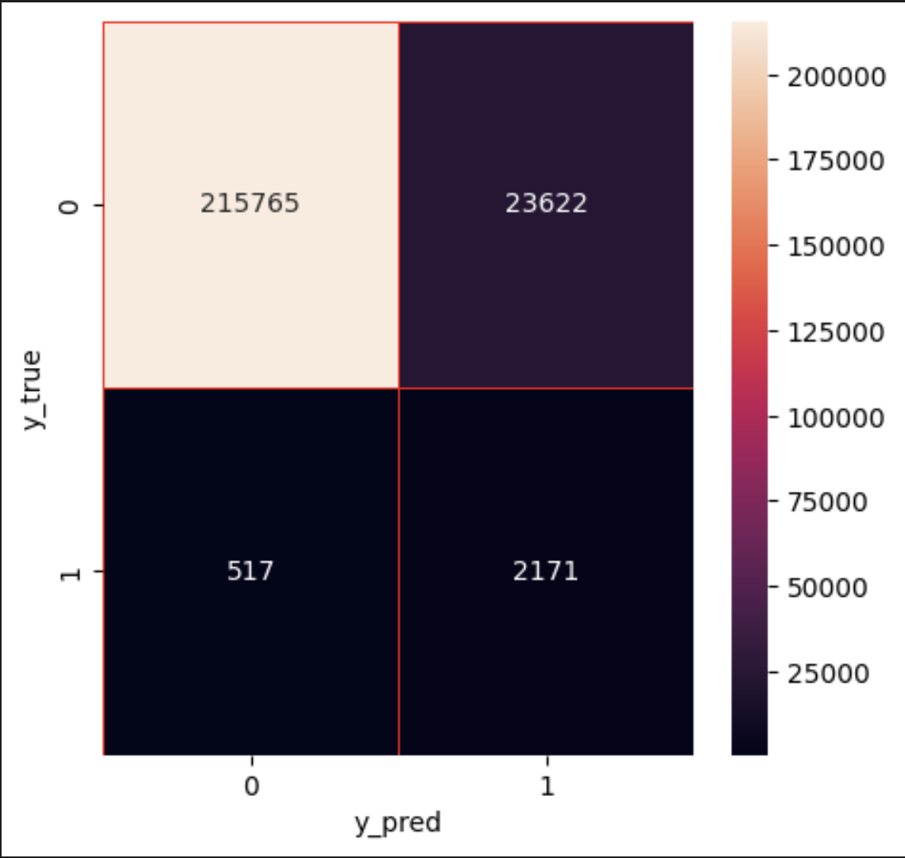
Results (Modeling Part)
Model | Data Set | Accuracy | Recall | Precision
Decision Tree | Train | 0.946 | 0.9651 | 0.9814
 | Valid | 0.8818 | 0.9079 | 0.8445
 | Test | 0.8633 | 0.8065 | 0.0605
Random Forest | Train | 0.9981 | 0.9982 | 0.9998
 | Valid | 0.9194 | 0.9513 | 0.9727
 | Test | 0.9003 | 0.8077 | 0.1878
Light GBM | Train | 0.9941 | 0.9954 | 0.9997
 | Valid | 0.9221 | 0.9513 | 0.9675
 | Test | 0.9069 | 0.7939 | 0.2052
Confusion Matrix
All three Models Accuracy

Slide 10
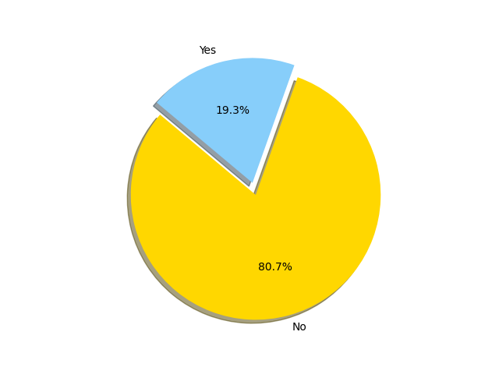
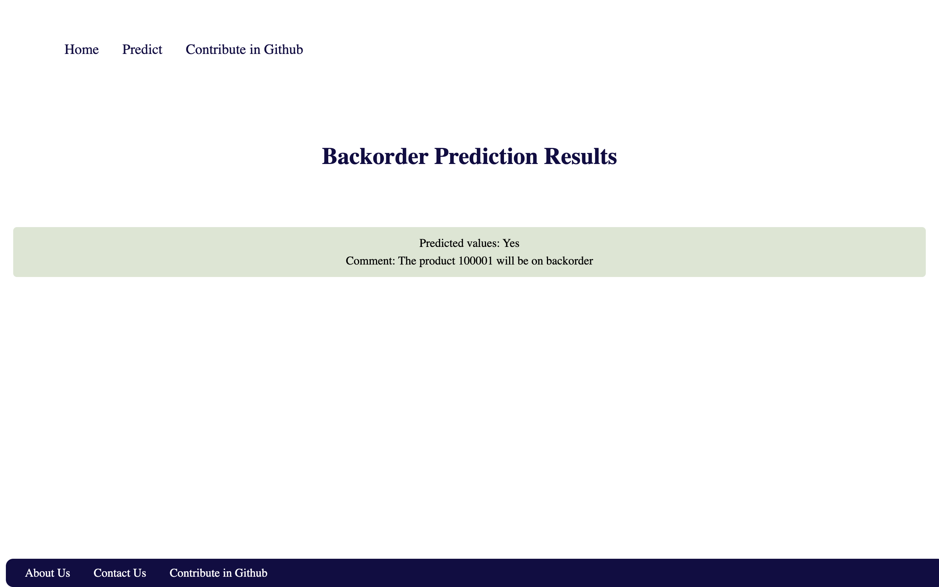
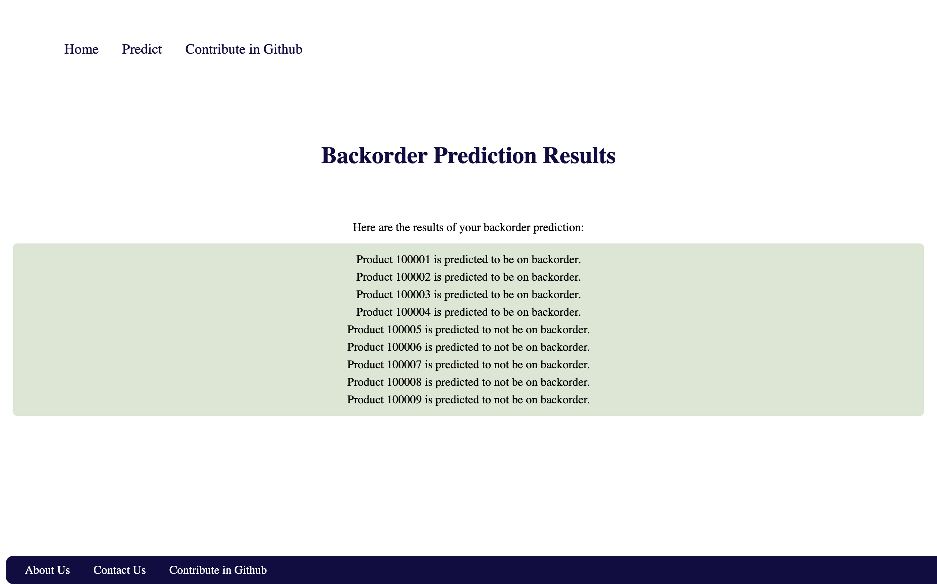
Results (UI Part)
Single Product Backorder Prediction
Multiple Products Backorder Prediction

Slide 11
Future Scope
Improved accuracy: Machine learning algorithms can be trained on large amounts of historical data to accurately predict backorders and identify patterns in demand, which can lead to better decision-making and inventory management.
Real-time prediction: Machine learning models can be deployed in real-time to analyze incoming data and make predictions on the fly, enabling businesses to respond quickly to changes in demand.
Integration with other systems: Machine learning can be integrated with other systems, such as supply chain management, to provide a comprehensive view of inventory levels and demand patterns, enabling better decision-making.
Personalization: Machine learning can be used to personalize recommendations and promotions for individual customers, based on their purchase history and predicted demand.
Enhanced forecasting: Machine learning can be used to analyze a wide range of data sources, including social media and online search trends, to provide a more accurate forecast of future demand and potential backorders.

Slide 12

Conclusion
Accurate backorder prediction helps organizations optimize their inventory management system and ensure timely product availability.
The model helps organizations avoid supply chain disruptions, reduce costs associated with overstocking and stockouts, and increase revenue by meeting customer demand.
Overall, the backorder prediction end-to-end model is an effective tool for businesses to manage their inventory and improve their supply chain efficiency.

Slide 13
Thank You

